Slide 1
Investment Forecasting
(Monte Carlo Simulation)
BY TEAM 2: FARIDA, DIEGO, AHMED, BRANDON

Slide 2
INTRODUCTION & PROBLEM STATEMENT
Project background & context
Problems you want to find answers
Investing is uncertain, and returns vary with market conditions and volatility.
Using Yahoo Finance data, our project runs 10,000+ Monte Carlo simulations on a $250K portfolio comparing the long-term performance of stocks vs Index funds to estimate returns and risk probabilities.
Our goal is to develop a simulation tool that helps investors and analysts compare and outperform index funds vs select individual stocks using monte carlo simulation.
How can we estimate future investment performance under market uncertainty?
What is the probability of gains or losses over time?
Would the monte carlo simulation on individual select stocks outperform index funds(SPY, QQQ, AGG)?
Notes:
Brandon

Slide 3



End-to-End Data Processing
- Extract data from yfinance API (Ticker prices for AAPL, MSFT, GOOGL)
- Transform using Python (Pandas for cleaning, NumPy for Monte Carlo)
- Load into PostgreSQL Database

Slide 4
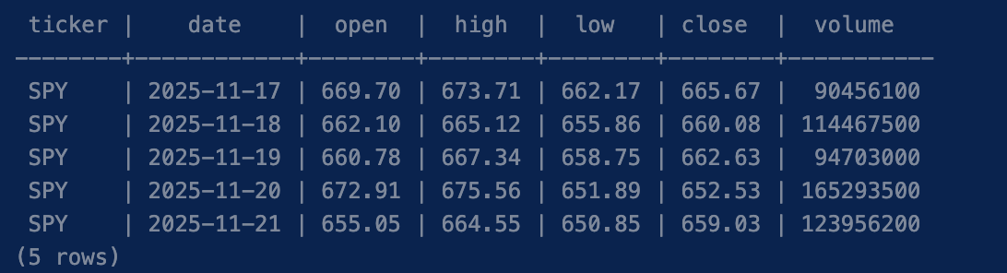
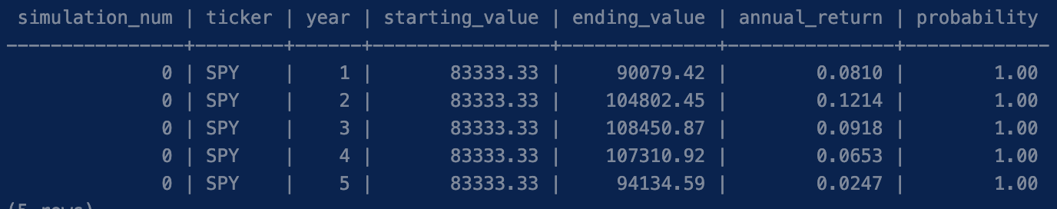
Psql Database in 2nd Normal Form (2NF)
What is 2NF?
Ensures all non-key columns depend on the entire primary key — no partial dependencies.
Our Implementation:
Two separate tables: stock_data and simulation
Each table uses a single primary key (id) — all columns depend fully on it
It stays organized and avoids repeating data, regarding 2NF.

Slide 5
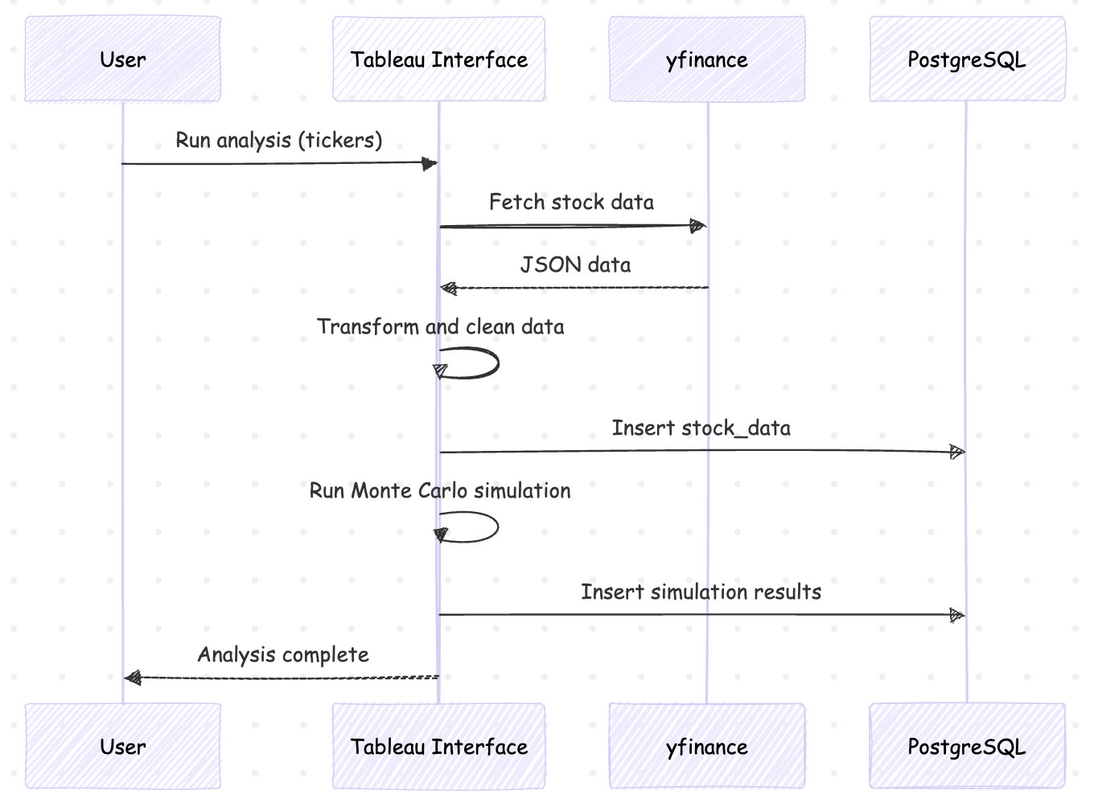
Sequence Diagram
ETL flow
Extract from yfinance API
Transform & clean data
Load into PostgreSQL
Run Monte Carlo simulation
Store results.

Slide 6
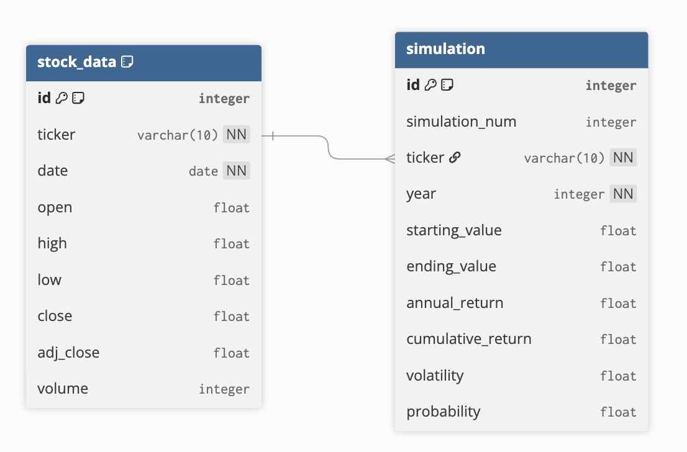
Data Model
2NF Compliant: Both tables use surrogate primary keys (id) with no partial dependencies
Linked by ticker: stock_data feeds historical prices into Monte Carlo simulations stored in simulation

Slide 7
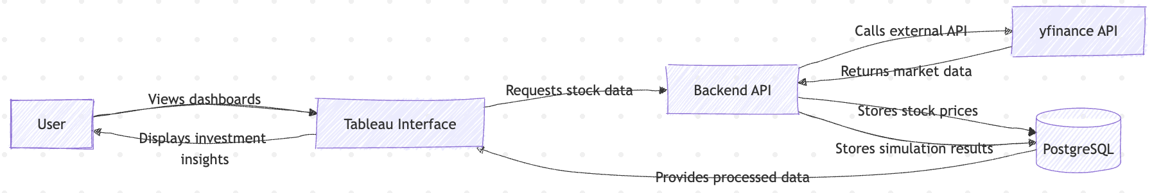
Data flow Diagram
Data Pipeline: Real-time market data is extracted from yfinance, processed through 10,000 Monte Carlo simulations, and stored in PostgreSQL

Slide 8
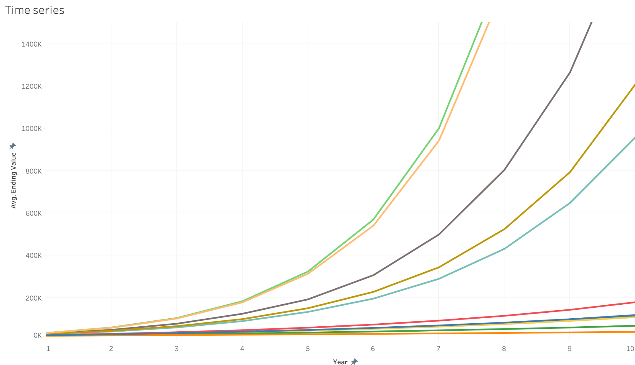
Time Series
Graph of average ending value per year
The best individual stocks(Google, Tesla, etc) have a greater rate of change as time goes on.
ETFs and stocks like Amazon are more stagnant

Slide 9
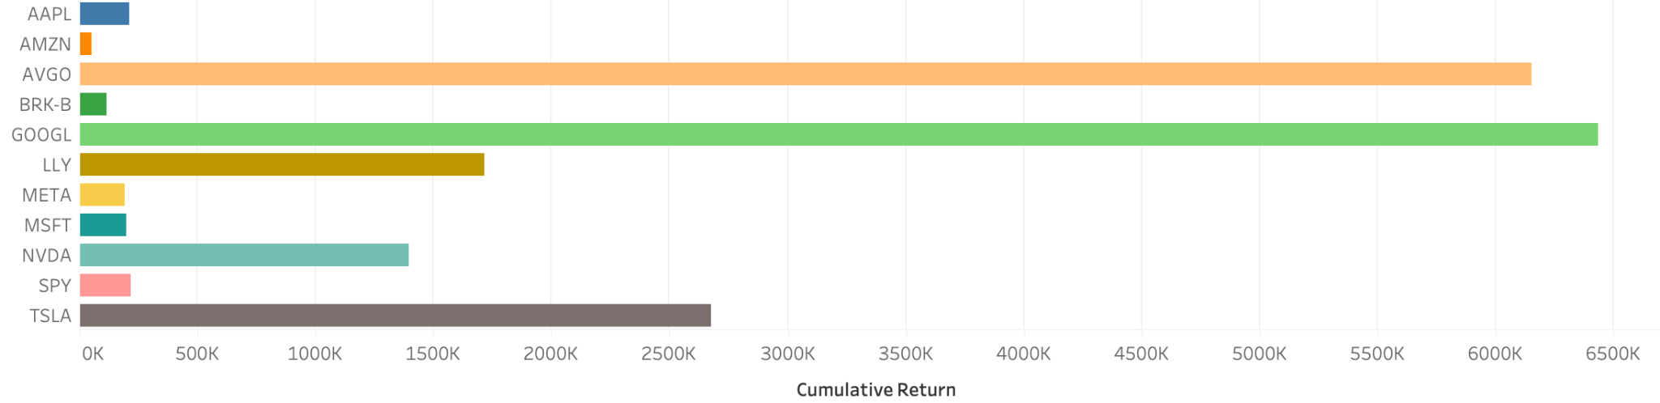
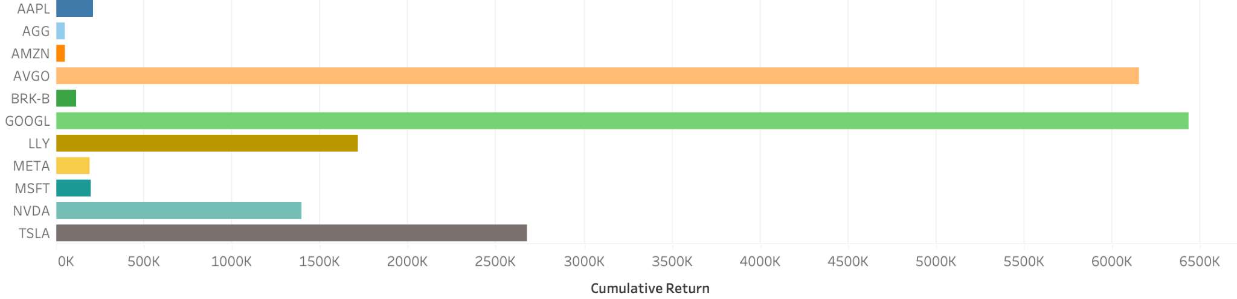
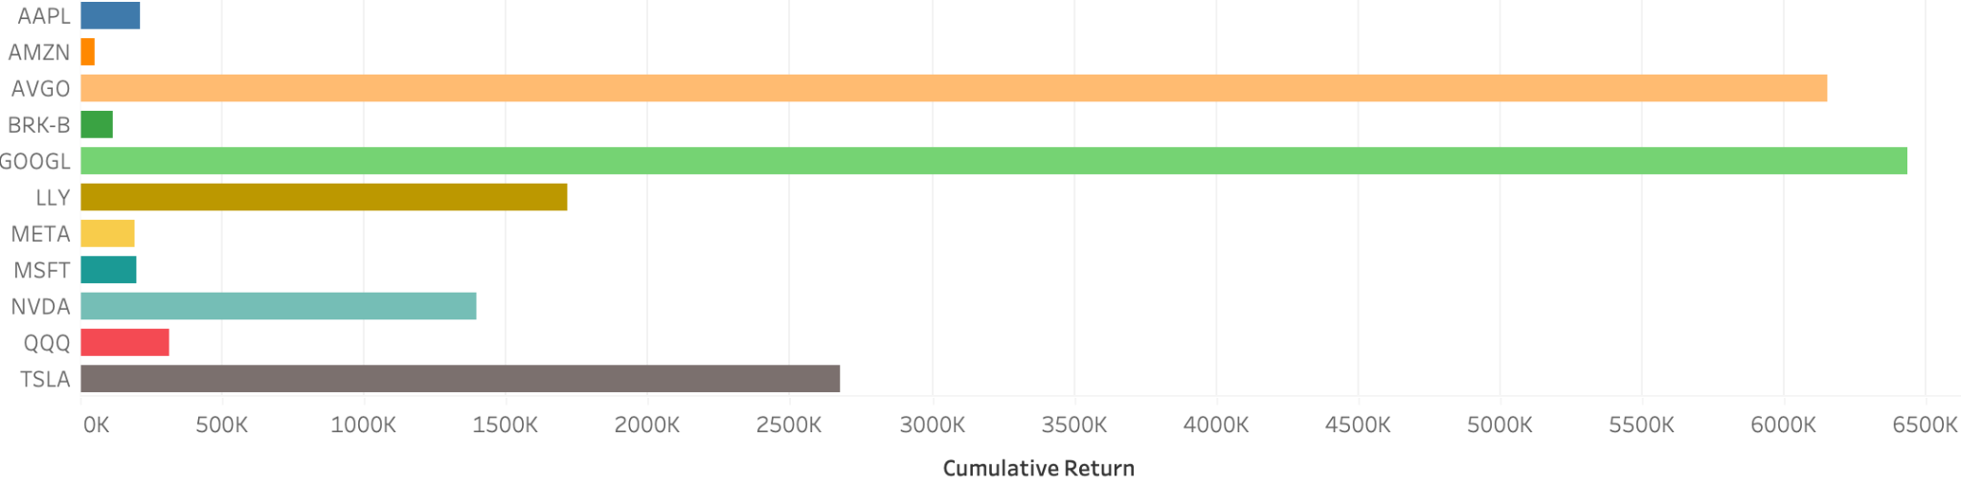
Cumulative Return Analysis
SPY
AGG
QQQ
Individual stocks often grant more returns, this could be due to recency bias
QQQ performs the best compared to other ETFs in terms of cumulative returns
AGG performs the worst compared to other ETFs

Slide 10
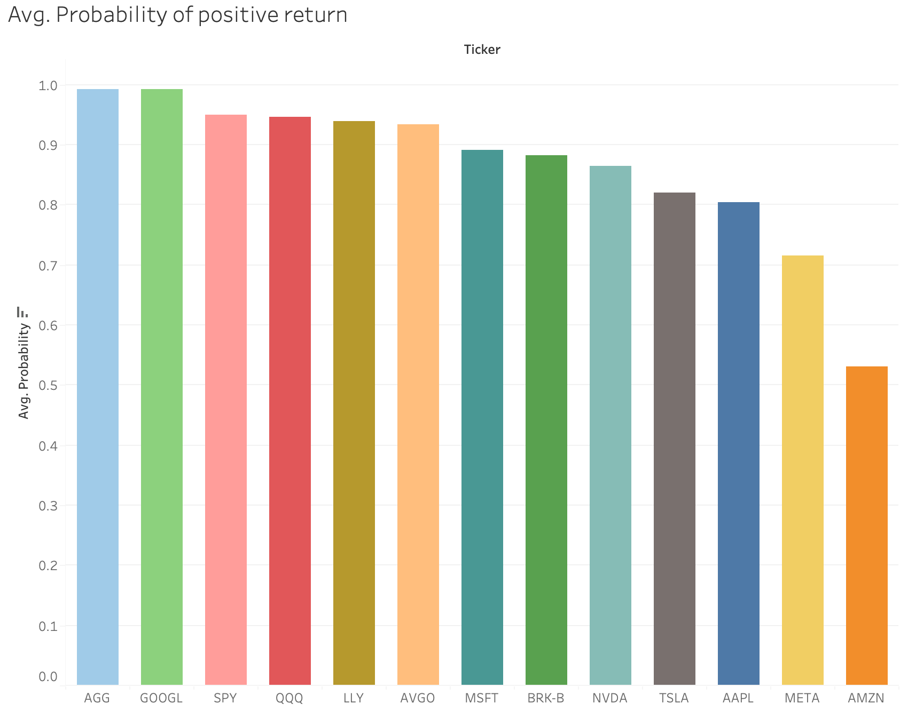
Probabilities
Graph of probabilities of positive return
ETFs have a higher probability of giving you a return on your money
Individual stocks are more riskier, and stocks like Amazon feel like a coin toss.

Slide 11
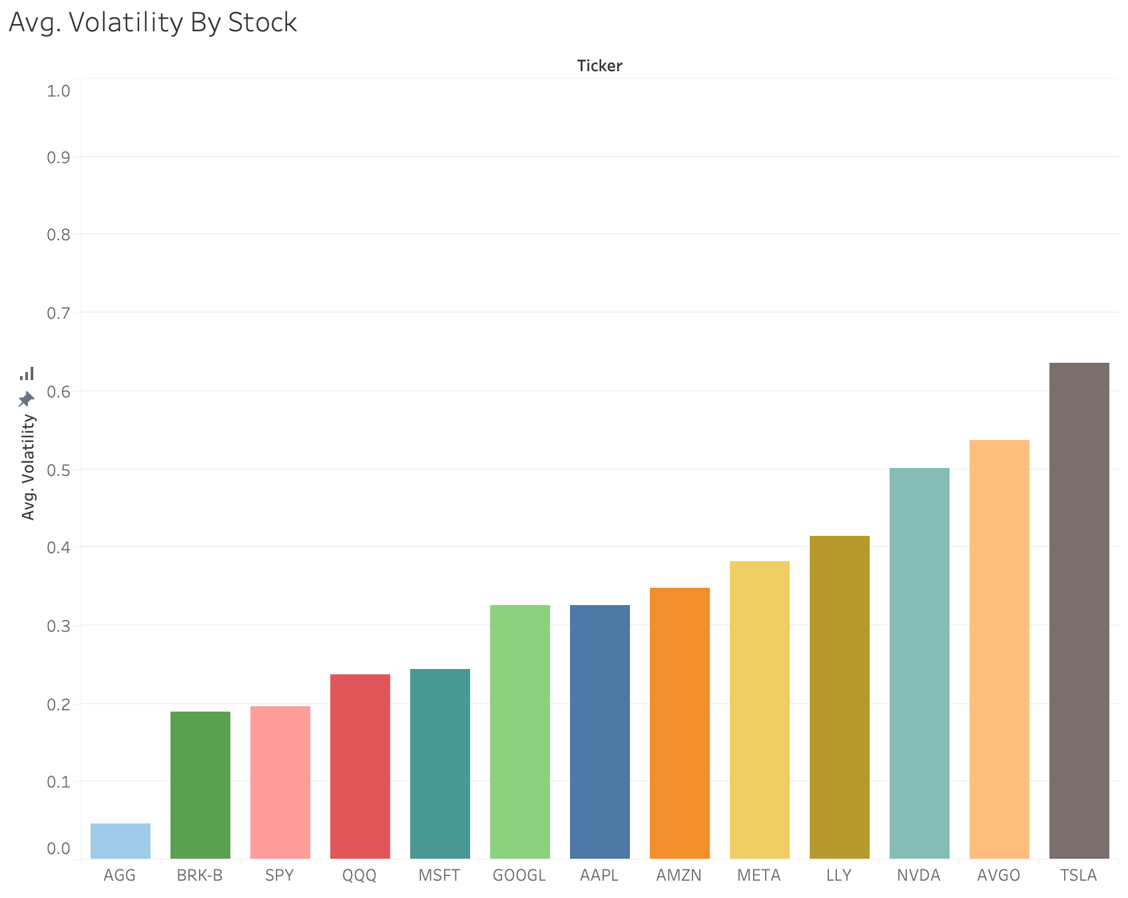
Volatility
Graph of volatilities of stocks and ETFs
ETFs have lower level of volatility on average, AGG is the safest ETF
Individual stocks are more volatile on average, and can skew farther than ETfs

Slide 12
Model Performance
Prediction: Carefully selected individual stocks will consistently outperform broad index funds such as SPY, QQQ, and AGG.
Outcome: While index funds typically exhibit lower volatility and greater stability compared to individual top market capitalization stocks, targeted investment in select stocks is expected to generate superior returns over time.

Slide 13
Tableau Live Demo!

Slide 14
Thank You! Q&A?

Slide 15
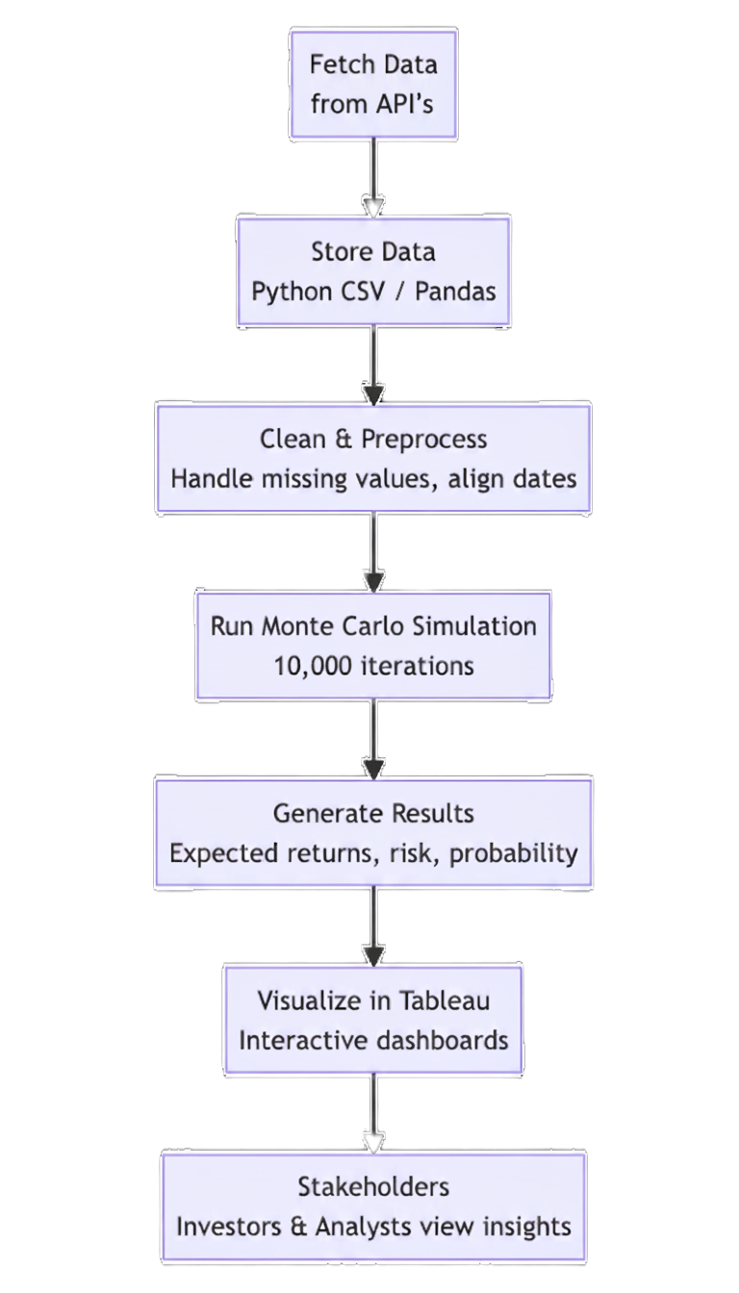
METHODOLOGY
Data Collection: Fetch current & historical data from Yahoo Finance for SPY, QQQ, AGG, & select stocks.
Storage: Save data in CSV or Pandas DataFrames.
Processing: Clean data, align dates, and calculate returns in Python.
Simulation: Run 10,000+ Monte Carlo simulations for 10–20 years.
Visualization: Use Tableau to display risk, return, and probability outcomes.
Stakeholders: Investors and analysts view interactive dashboards to compare results.
Notes:
ahmed

Slide 16

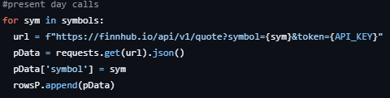
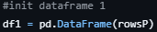
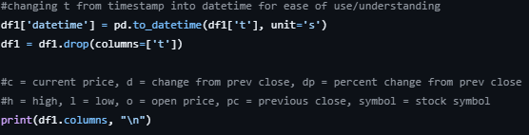
Data Collection
For our stock datasets we utilized yFinance
We used get requests to obtain the data we required in order to build our dataframes for our monte carlo simulations.
We cleaned the data by changing formatting, such as converting the ‘t’ row to datetime.
yFinance seems better for historical data
Notes:
Farida

Slide 17
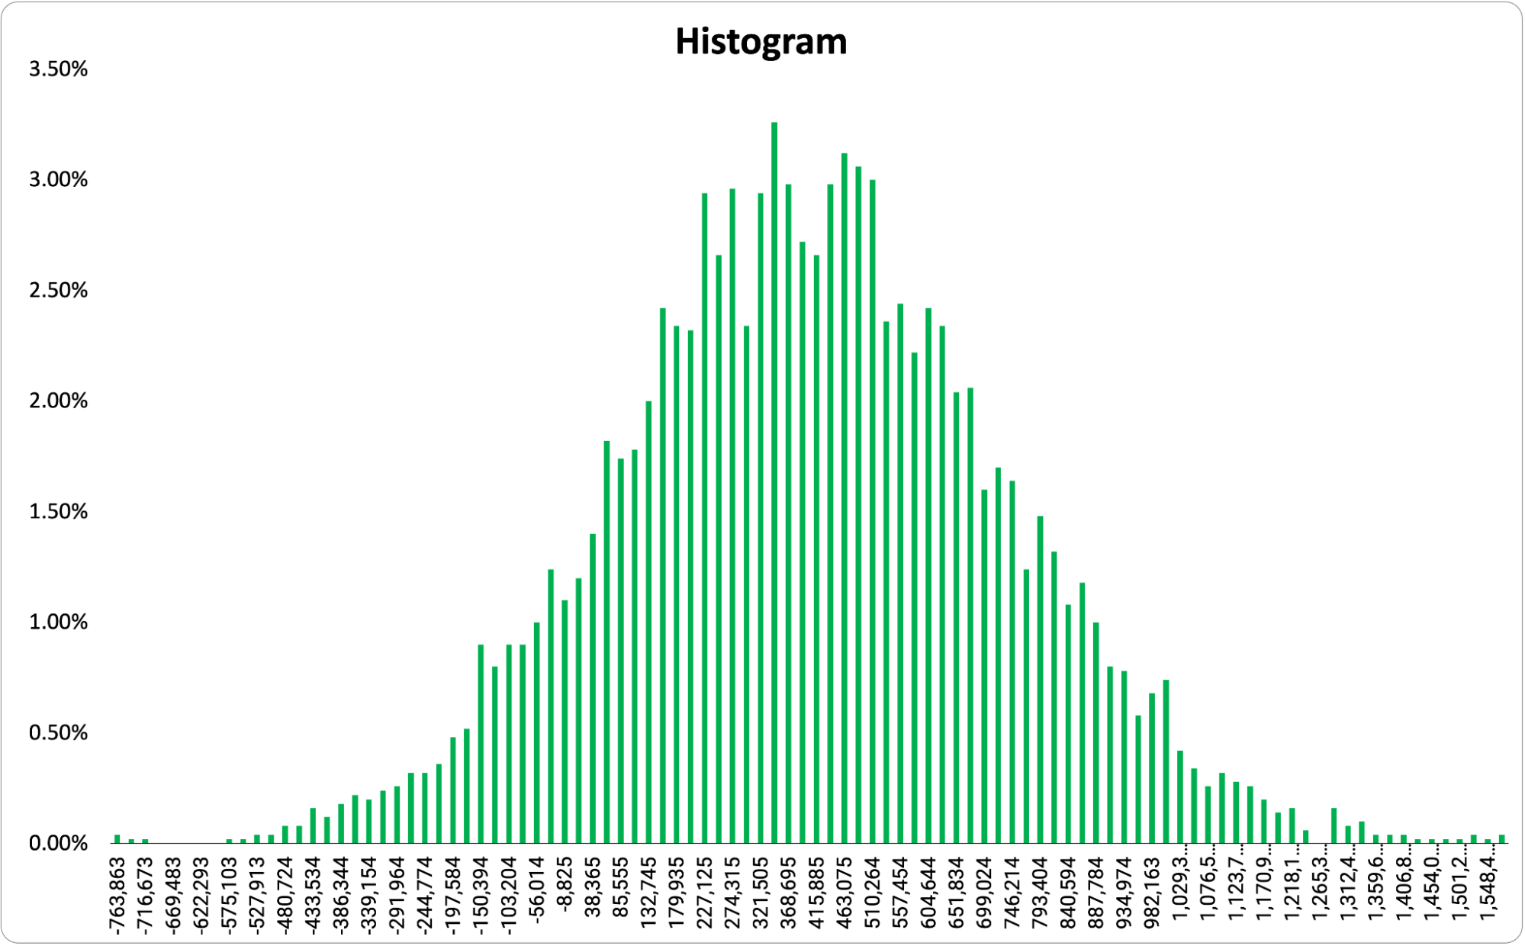
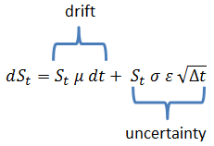
Monte Carlo Method
Example
Monte Carlo is a method of running a large amount of random trials.
Gives insight to future trends, while accounting for uncertain probabilities.
We can use historical data in order to create a basis for simulations
After 10,000 simulations we can gather data describing worst/best/average case.
Our monte carlo method will utilize the Geometric Brownian Motion model
Notes:
Diego

Slide 18
Monte Carlo Simulation
We will use our previously calculated mean and stdev from our portfolio as part of our simulations
We will simulate controlled market randomness by inducing spikes into our data
Using the GBM formula we can calculate the price path for our simulation.
Insert our results from the simulation into our result array.
port_mean #mean of portfolio
port_stdev #standard deviation of portfolio
dt = 1/days #time step to account for everyday in the year
for i in range(num_simulations):
#An array representing the daily random shocks that occur
spikes = np.random.normal(0, 1, days)
#GBM formula, simulates change of returns
daily_returns = np.exp((port_mean - 0.5 * port_stdev**2) * dt + port_stdev * spikes * np.sqrt(dt))
#Computing our portfolio’s cumulative value
price_path = initial_investment * np.cumprod(daily_returns)
#simulation results array
simulation_results[:, i] = price_path
Notes:
Diego

Slide 19

VISUALIZATION: TABLEAU
IDEAS
Build Dashboard
Extract Data
DATABASE: Stream data to source (mysql) tableau can connect directly to
Push data into SQL database , connect to server and click refresh to see new Updates
API CONNNCTION : Create connector script (tabpy) that calls API yfinance. Tableau connects directly to the Web data connector and this provides live feed without refresh (BUT COMPLEX)
PROBABILITY DISTRIBUTIONS
GROWTH OVER TIME
BEST WORST CASE SCENARIOS
COMPARISON BETWEEN INDEX FUNDS AND PORTFOLIOS
ANSWER QUESTIONS LIKE
What is the value of my investment over time
Can i filter for different stocks or ETFs
Can i see the live feed/updates of the the stocks

Slide 20
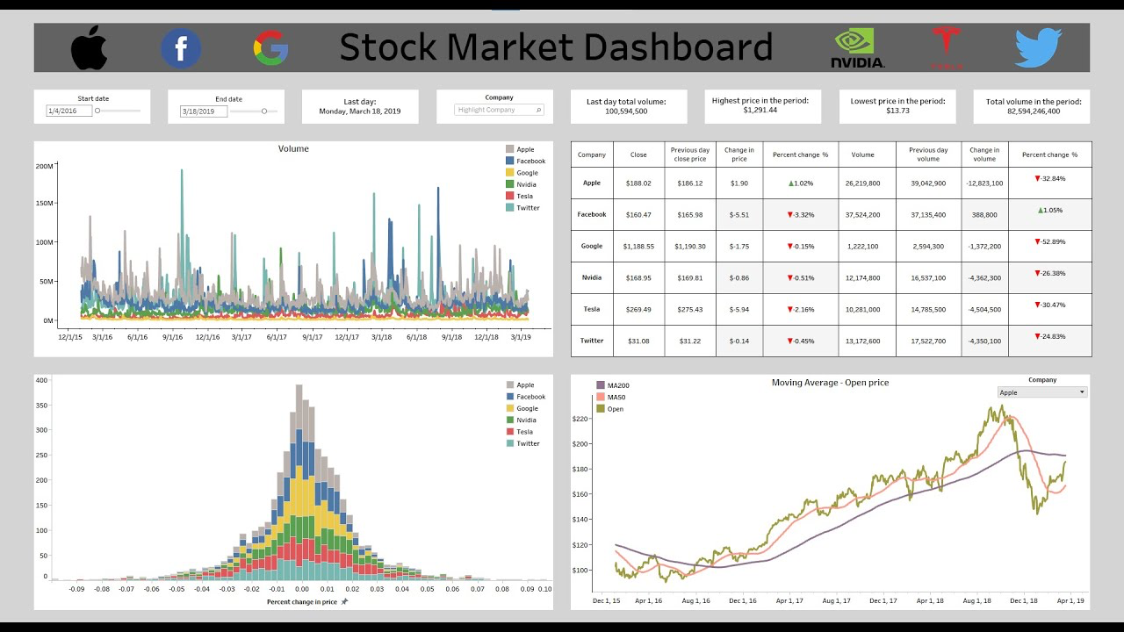
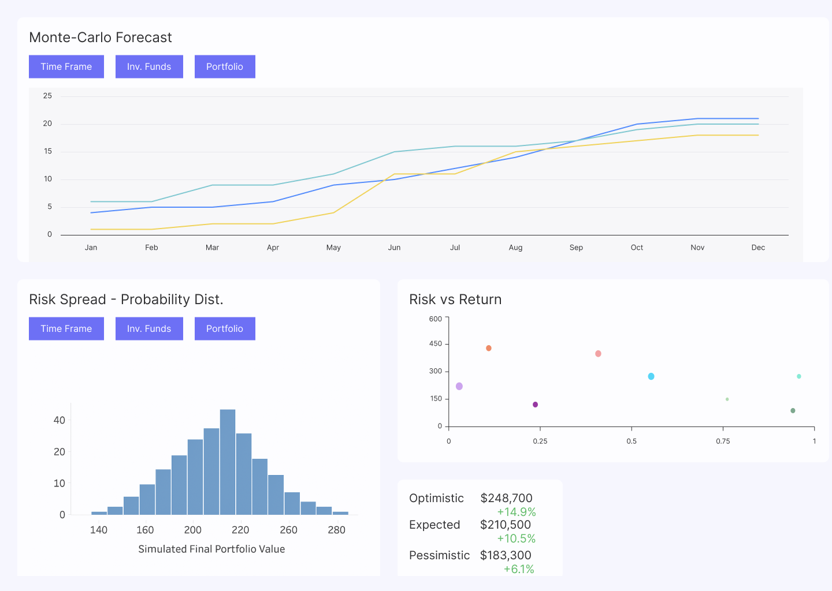
Text Tables
Density Curve
Line Charts
Trend lines
Box plot,Etc
DASHBOARD
WHAT YOU MIGHT SEE

Slide 21





Tech Stack & Flow
Source latest
Stock Data
Extract
stock data
Clean, format, and process data
Monte Carlo Sim.
CSV
Generate CSV file
Display data to user through dashboard
Notes:
Brandon

Slide 22
Roles
Data Engineer
Data Analyst
Ahmed
Farida
Data Engineer
Data Analyst
Diego
Brandon

Slide 23
Investment Simulation & Forecasting
We are trying to 250k over 10 and 20 years and predict the outcome of the investment showing the effect moderate low and high risk investments using visualizations. The basic idea is to
Explore financial API’s (in our case Finnhub)
Fetch historical prices using our code written in Python
Provide live feed and Trends over time using Tableau
Predict and Show correlations between sets based on out outcomes
The goal is to use Monte Carlo Simulations to generate random scenarios, Model over 10 to 20 years and then for each simulation calculate different aggregations like mean, median, best case, worst case scenarios etc

Slide 24
Key ideas in market opportunity_
Research new markets
Analyze existing customer needs and identify gaps in the market to find new opportunities
Innovative solutions
Utilize technology and customer feedback to come up with novel solutions that meet your customer’s demands or needs
Stay ahead of trends
Monitor changes in the marketplace, such as shifts in consumer behavior or emerging technologies, to stay competitive and capitalize on new opportunities and trends
Seasonal spikes
Identify times of year when demand for certain products may spike, such as holidays or special occasions, and use these times to target customers or maximize sales

Slide 25
Six recommendations_
Keep it simple
Use visuals
Keep it short
Structure your pitch deck clearly and make sure all the important points are easy to understand
Incorporate visuals or graphics to illustrate your message and keep the audience engaged
A good pitch deck should be concise and clear; avoid trying to cram in information in excess
Make it memorable
Test & iterate
Main points
Include impactful stories, statistics, or facts that will help your audience remember your message after the presentation
Practice presenting your deck beforehand with friends or colleagues for feedback, then use this input to refine it further
A pitch deck is an overview of your business; focus on key points that get the most important ideas across

Slide 26
333,000_
9h 55m 23s_
386,000 km_
Users bought our product
Estimated delivery time per unit
Avg. Distance travelled by logistics team

Slide 27
4,498,300,000_
Number of users analyzed in our market research

Slide 28
Competition comparison_
 | Team A | Team B | Team C | Team D | Team E
Mercury | Yes | Yes | No | Yes | Yes
Mars | Yes | No | Yes | Yes | No
Saturn | No | Yes | Yes | No | No
Venus | Yes | Yes | Yes | Yes | Yes
Jupiter | No | No | Yes | Yes | Yes
Earth | Yes | Yes | No | No | Yes

Slide 29
Timeline of your presentation_
Provide a brief overview of the pitch deck content
Engage the audience with a concise and compelling company introduction
Identify the target customer pain points and challenges in a brief manner
Describe how your product or service can solve the problem
Highlight the unique value proposition and benefits of your solution
Analyze the target market size, growth potential, and competition briefly.
Explain your financial needs and briefly outline your funding allocation
End with a clear and concise call to action

Slide 30
Organizational chart_
Sun
CEO
Jupiter
Neptune
Department Head
Department Head
Venus
Mars
Ceres
Earth
Manager
Manager
Manager
Manager
Mercury
Uranus
Titan
Saturn
Pluto
Employee
Employee
Employee
Employee
Employee

Slide 31
Market size overview_
Include the total size of the market, which represents the entire potential customer base for the product or service
Outer circle
$75M
$55M
Identify the target market for the product or service, which may be a subset of the total market. This could be based on factors such as demographics, geography, or specific needs
Middle circle
$35M
Indicate the current market size, which represents the portion of the target market that the company has successfully captured
Inner circle

Slide 32
Roadmap infographics_
 | Jan |  |  | Feb |  |  | Mar |  |  | Apr |  |  | May
Task 01
Task 02
Task 03
Task 04
Task 05
Team 01
Give a brief description of this team and their responsibilities
Team 02
Give a brief description of this team and their responsibilities

Slide 33
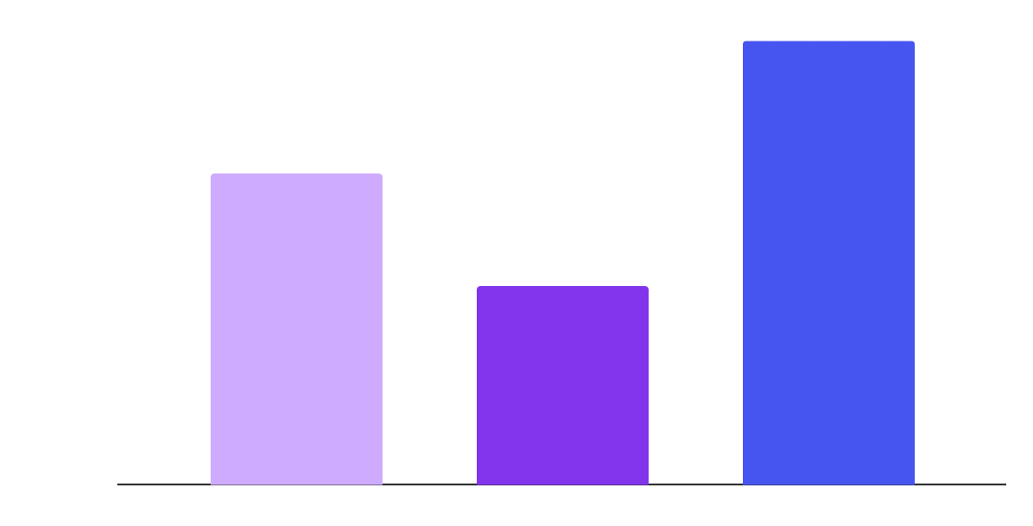
KPI dashboard_
70%
45%
100%
Development was mostly good in the beginning
The company faced some difficulties halfway
Bugs were fixed and the final product is ready
Product | Column 1 | Column 2
Jupiter | 50% | 2,000,000
Saturn | 20% | 50,000
Mercury | 100% | 1,500,000
Follow the link in the graph to modify its data and then paste the new one here. For more info, click here

Slide 34
Icon pack_

Slide 35
Alternative resources_
Here’s an assortment of alternative resources whose style fits that of this template:
Vectors
Landing page template artificial intelligence
Landing page neon with smartphone

Slide 36
Resources_
Did you like the resources on this template? Get them at our other websites:
Photos
Side view of man using smartphone
Side view woman working on digital monitors
Vectors
Artificial intelligence template landing page
Artificial intelligence landing page
Artificial intelligence landing page template
Icons
Icon Pack: Artificial intelligence | Filled

Slide 37
Instructions for use
If you have a free account, in order to use this template, you must credit Slidesgo by keeping the Thanks slide
As a Free user, you are allowed to:
Modify this template
Use it for both personal and commercial projects
You are not allowed to:
Sublicense, sell or rent any of Slidesgo Content
Distribute Slidesgo Content unless it has been expressly authorized by Slidesgo
Include Slidesgo Content in an online or offline database or file
Offer Slidesgo templates (or modified versions of Slidesgo templates) for download
Acquire the copyright of
Slidesgo Content
For more information about editing slides, please read our FAQs or visit our blog

Slide 38
Instructions for use (premium users)
As a Premium user, you can use this template without attributing Slidesgo or keeping the Thanks slide
You are allowed to:
Modify this template
Use it for both personal and commercial projects
Share this template in an
editable format
Hide or delete the “Thanks” slide and the mention to Slidesgo in the credits
You are not allowed to:
Sublicense, sell or rent any of Slidesgo Content
Distribute Slidesgo Content unless it has been expressly authorized by Slidesgo
Use any of the elements that are part in a separated way
Register any of the elements as a trademark or logo in an intellectual property registry
For more information about editing slides, please read our FAQs or visit our blog

Slide 39
Fonts
Colors
This presentation has been made using the following fonts:
All the colors used in this presentation
Click on the button of the link to the fonts
#ffffff
#0b0218
#ceabff
Trispace
#8134ec
#240155
#9101be
#4654f0
Maven Pro
To view this template correctly in PowerPoint, download and install the fonts we used

Slide 40
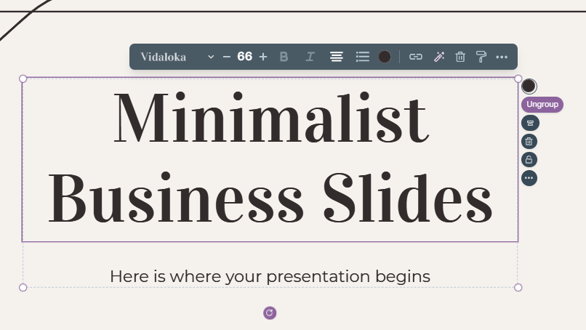
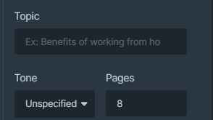
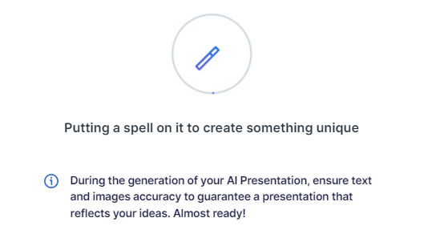
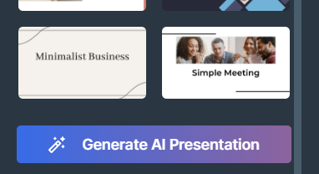
Presentation Maker
Slidesgo introduces its latest feature: the Presentation Maker. Enjoy two main functionalities - firstly, with a few clicks, create marvelous presentations with Artificial Intelligence that adapt to your needs. And it's completely free!
The second functionality of this tool is that you can edit presentations through the online editor. Create interactive resources easily, quickly and without the need for any software. Change everything or start from scratch
Generate AI Presentation
Edit online

Slide 41
Use our editable graphic resources...
You can easily resize these resources without losing quality. To change the color, just ungroup the resource and click on the object you want to change. You can also look for more infographics on Slidesgo

Slide 44
 | Jan | Feb | Mar | Apr | Jun
Task 1
Task 2
Task 3
 | No | Yes | Yes | No | Yes
 | Yes | No | Yes | No | Yes
 | Yes | Yes | No | Yes | No
 | Jan | Feb | Mar | Apr | Jun
Task 1
Task 2
Task 3

Slide 46
6/10 | 8/10 | 7/10 | 4/10

Slide 47
...and our sets of editable icons
You can resize these icons without losing quality
You can change the stroke and fill color; just select the icon and click on the paint bucket/pen
In Google Slides, you can also use Flaticon’s extension, allowing you to customize and add even more icons

Slide 48
Educational icons
Medical icons

Slide 49
Business icons
Teamwork icons

Slide 50
Help & support icons
Avatar icons

Slide 51
Creative process icons
Performing arts icons

Slide 52
Nature icons

Slide 53
SEO & marketing icons

Slide 54


